Slide 1


TO-DO LIST API

Slide 2
TEAM MEMBERS
2403A52032: BACHANAGARI DEEKSHITHA
2403A52033: CHALLA SRAVYA
2403A52057: NAGUNURI KOUSHIK

Slide 3
OBJECTIVE
Build a simple REST API to manage To-Do tasks.
Support basic CRUD operations (Create, Read, Update, Delete).
Create a user-friendly frontend for adding and viewing tasks.
Use AI logic to automatically assign task priority.
Store tasks in a lightweight database (SQLite).

Slide 4
STAKEHOLDERS
End Users People who want a simple tool to manage tasks.
Student Developer (You) Creates, maintains, and demonstrates the project.
Faculty / Instructor Evaluates the project and its functionality.

Slide 5
PROGRAMMING LANGUAGE & FRAMEWORK
Python → For backend + API development using Flask.
HTML → Structure of the frontend UI.
CSS → Styling and UI design.
JavaScript → Frontend logic, fetch API calls, task rendering.
SQL (via SQLAlchemy) → For storing tasks in SQLite.

Slide 6
TOOLS/SOFTWARE
Development Tools:
Visual Studio Code (VS Code) Main IDE for writing code.
Flask Framework Backend web framework for building APIs.
SQLAlchemy ORM used for database operations.
SQLite Database Lightweight file-based database for storing tasks.
HTML/CSS/JavaScript Frontend technologies.
Testing & Running Tools:
Command Prompt / Terminal To run the Flask server.
Web Browser (Chrome / Edge) To view and interact with the application.

Slide 7
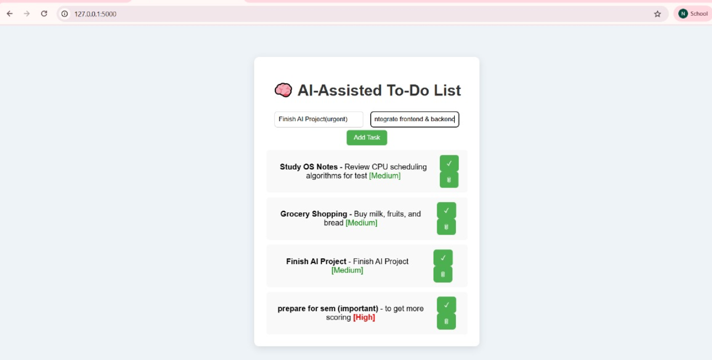
FRONTEND VIEW

Slide 8

Thank you

